Slide 1
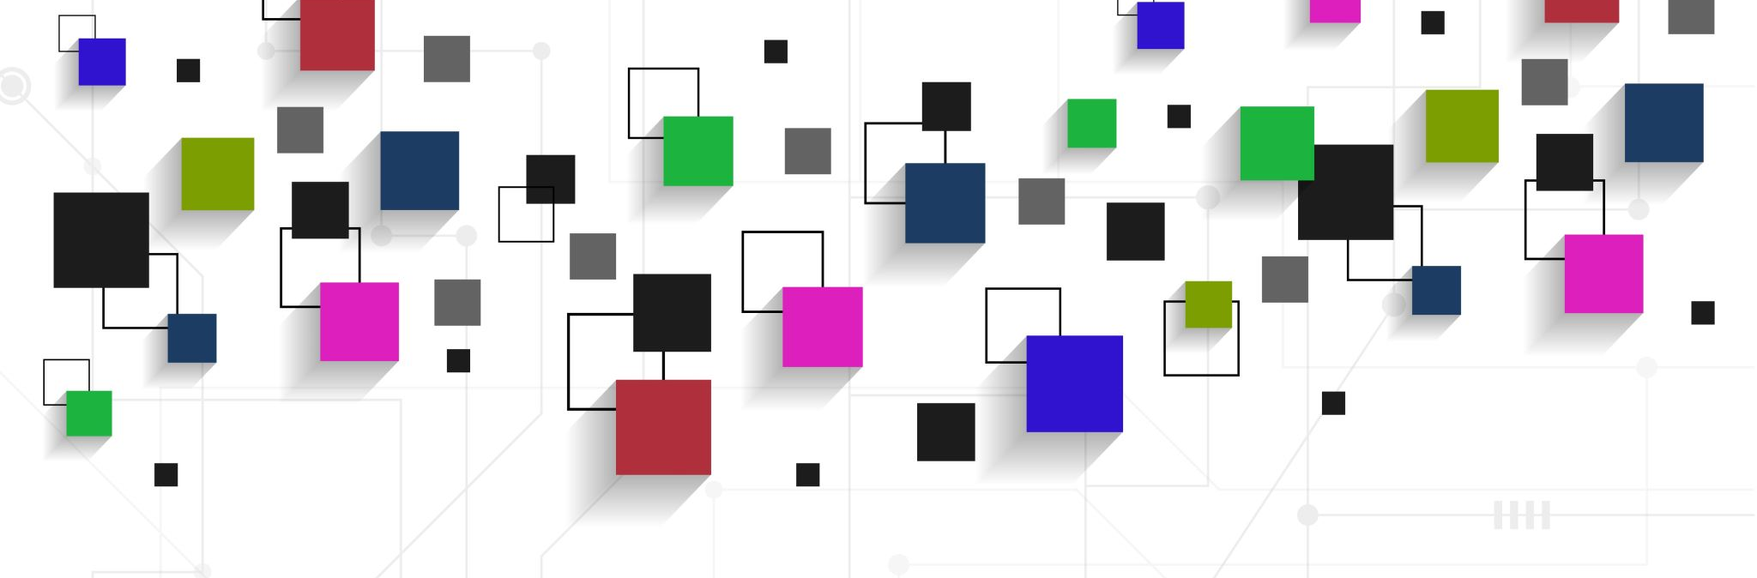
How to assay MA-line worms with Image-J

Slide 2
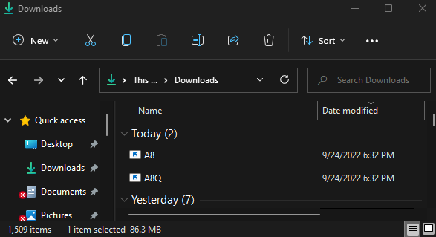
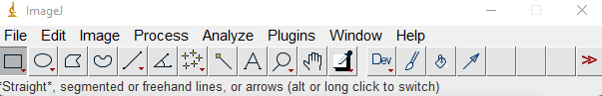
Step 1: Start ImageJ. Click and drag image files to taskbar to open

Slide 3
Bright-field image: Both MA-line and
N2 Bristol worms are visible
GFP fluorescent image: Only MA-line mutants
visible

Slide 4
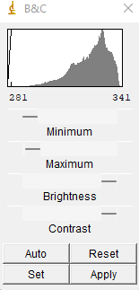
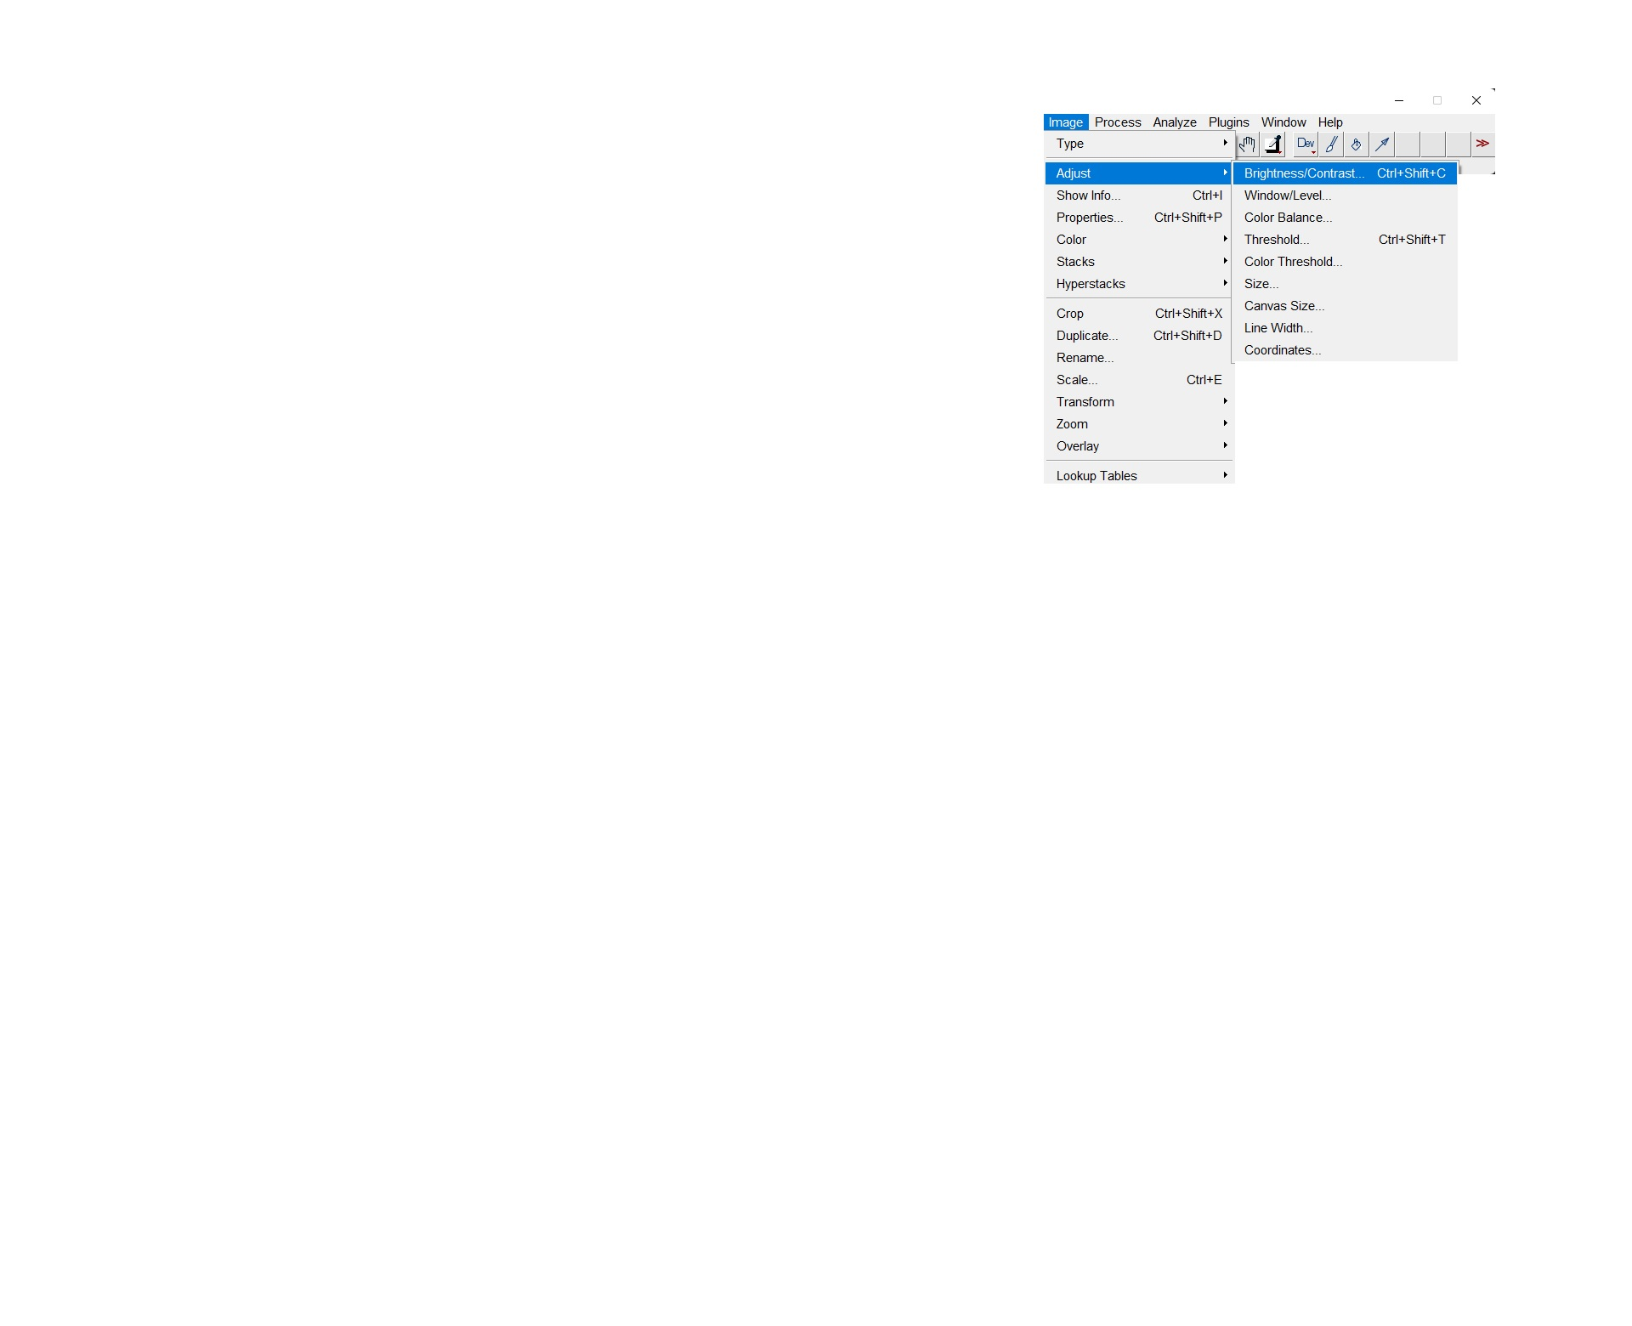
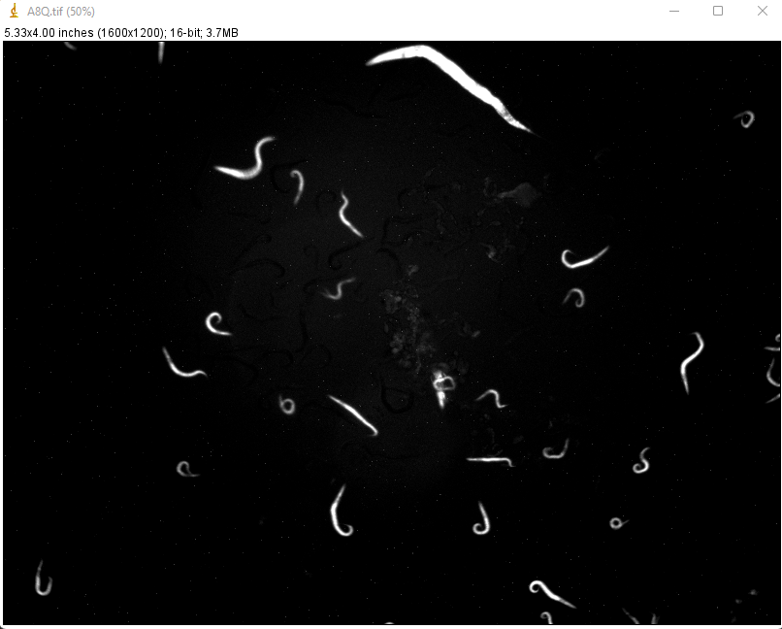
Step 2: Adjust brightness and contrast settings of GFP images
For best effect, set minimum and maximum light
settings low and contrast high. Adjust to
make sure all GFP-labeled
worms in are still visible. Click “Apply” when done.

Slide 5
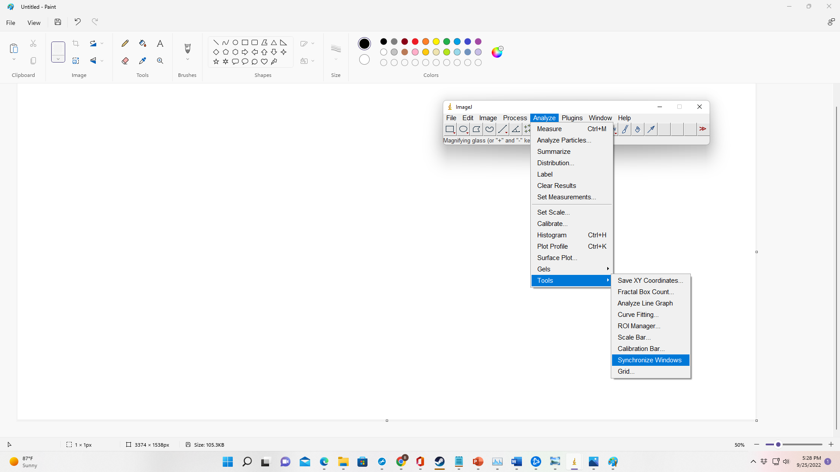
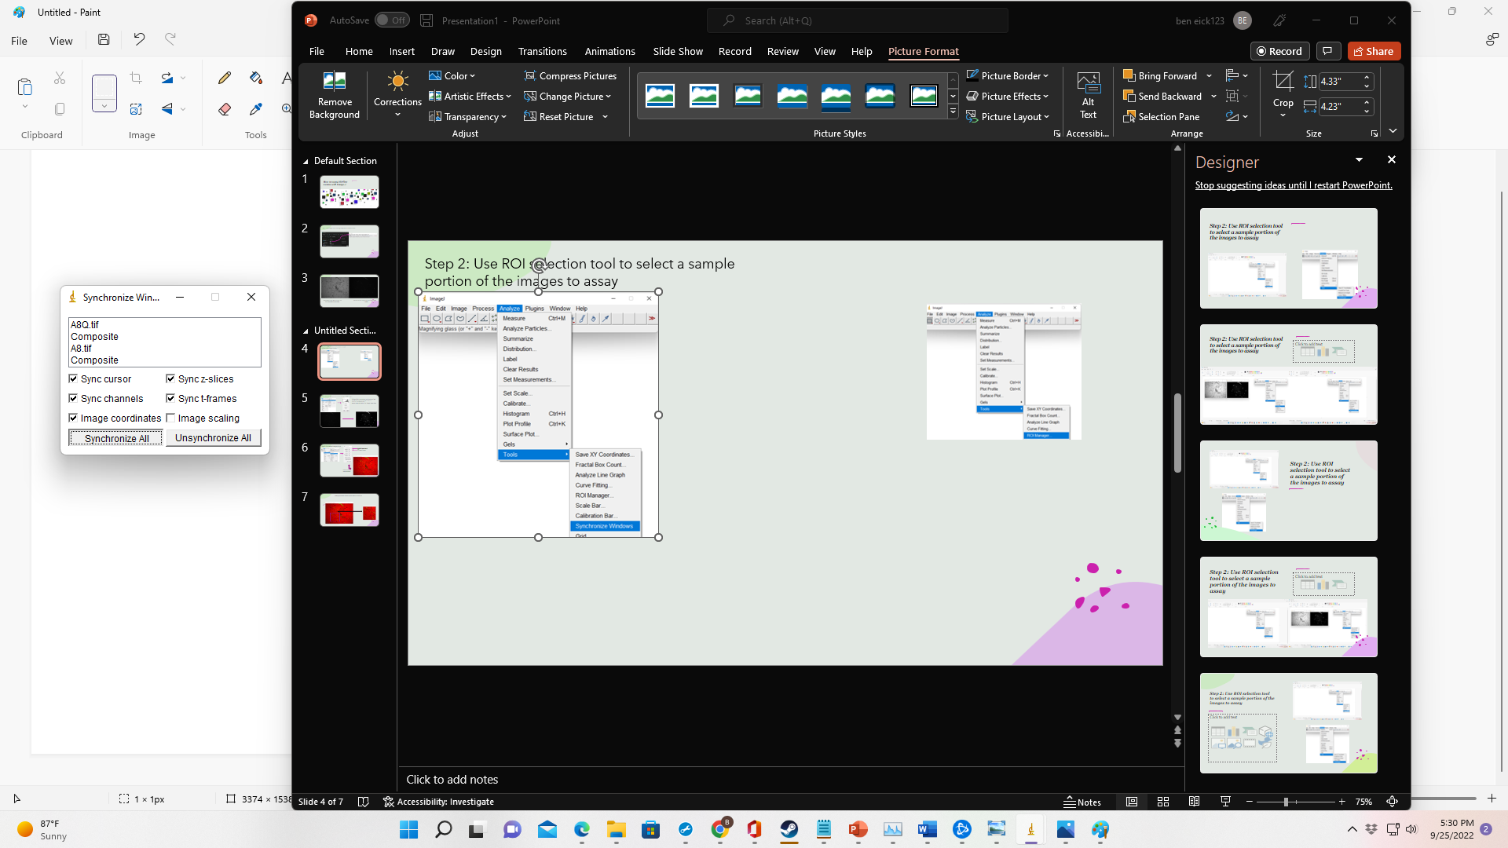
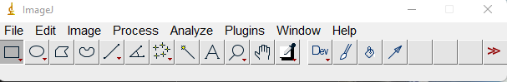
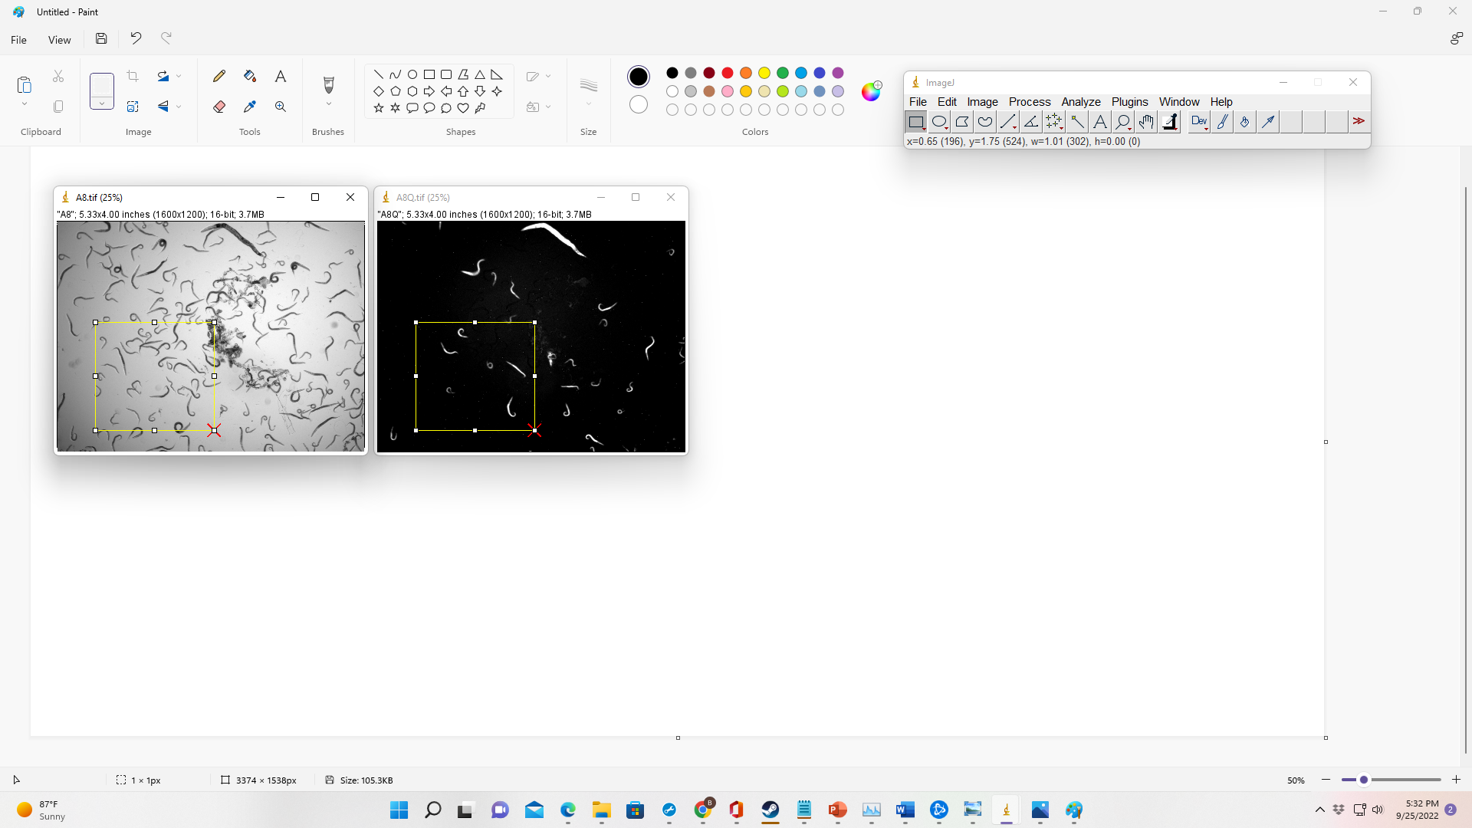
Step 3: Use ROI selection tool to select a sample portion of the images to assay
Select ROI selection tool
Then click and drag on one of the photos to select
the region you want to assay. Anything selected in one
photo will also be selected in the other photos
Anything you do
to one image will
now happen to all
synchronized images
Remember to unsynchronize photos when done

Slide 6
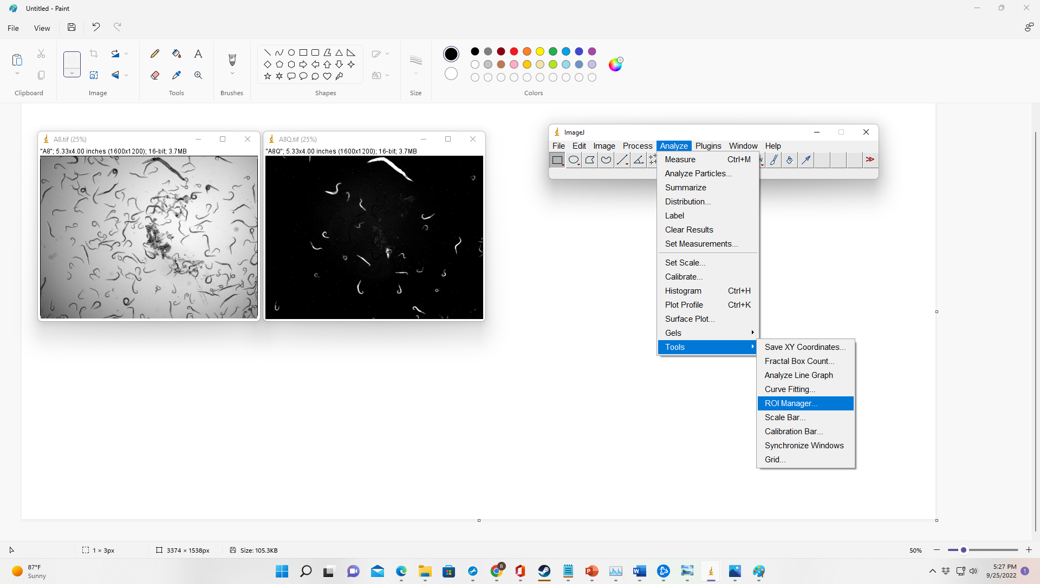
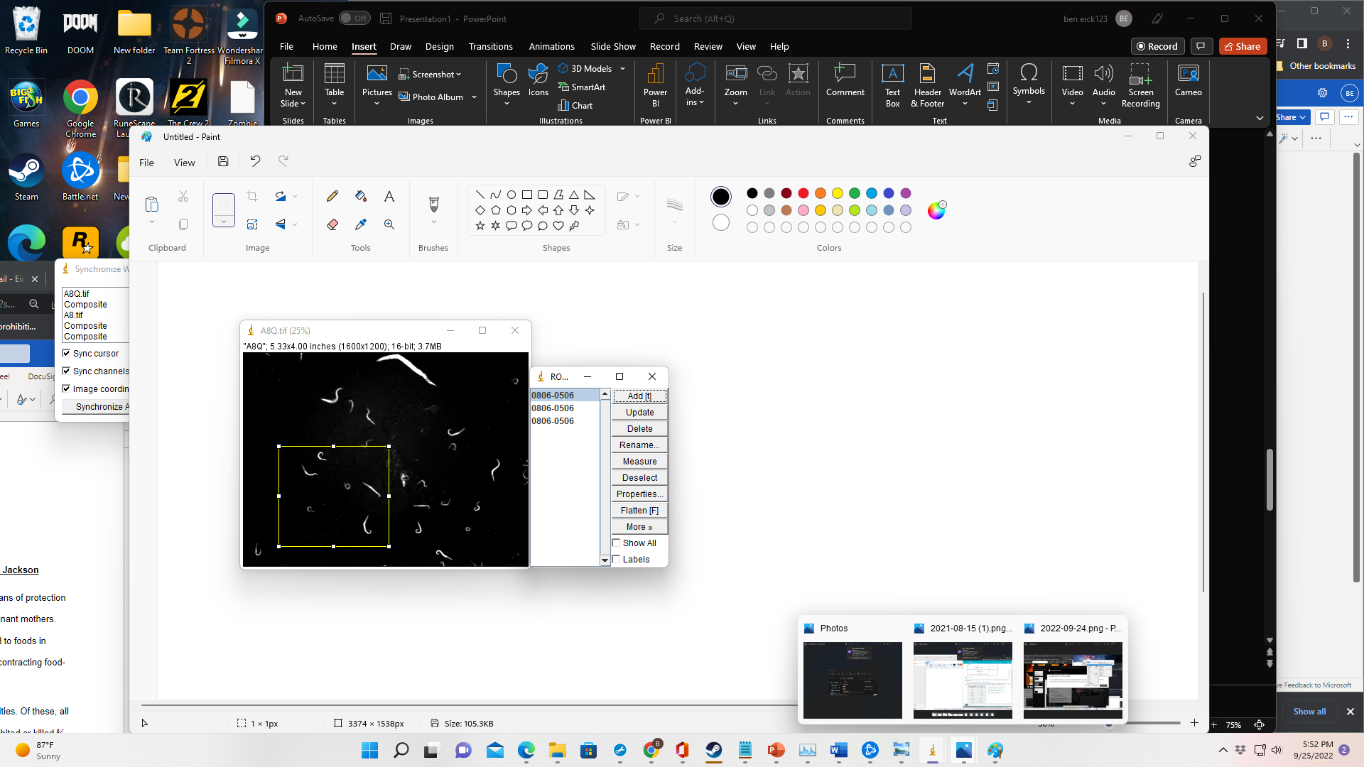
You can save selection boxes and import them to other images.
First: click on selection box and click “add” on ROI selection manager window
Second: Click “More” -> “save” to save selection box
If you restart ImageJ and want to add the saved selection box to another image: Click “More” -> “Open.” If the images are the same size, the selection box will appear in the same place in every image.

Slide 7
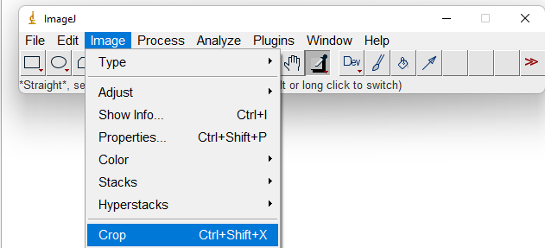
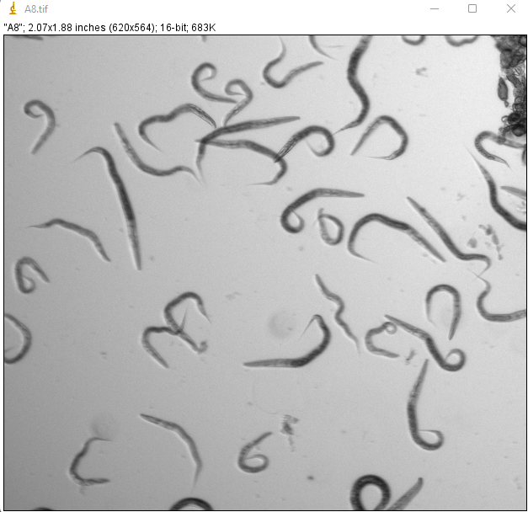
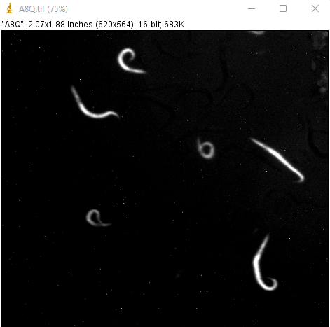
Step 4: Crop images

Slide 8
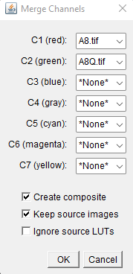
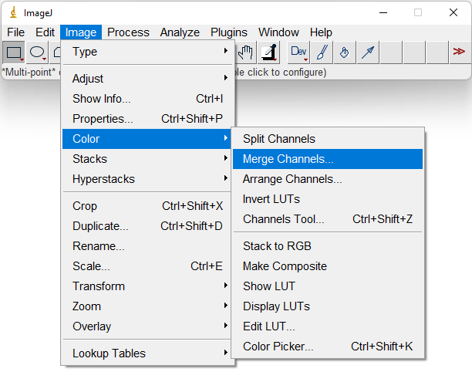
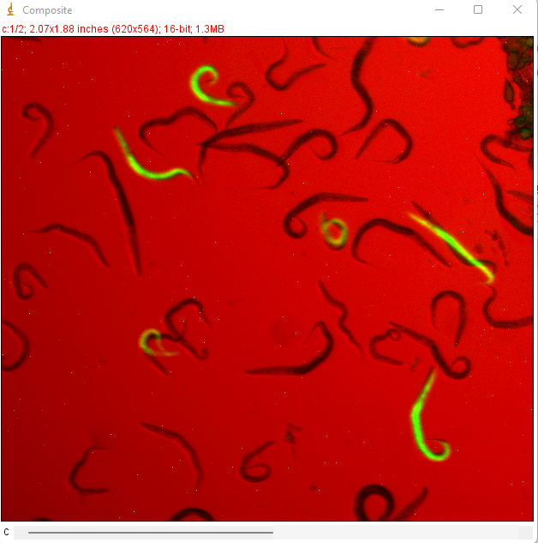
Step 5: Colorize and merge photos
Bright-field image set as red
GFP image set as green
MA-line mutants
are highlighted

Slide 9
Now it is easy to count and compare the number of MA-line mutants to wild-type N2 worms
Now it is easy to count and compare the number of MA-line mutants to wild-type N2 worms
There are 7 MA-line mutants to 33 wildtype
worms (not counting eggs)
The proportion found in the cropped image here
should be representative of the entire population

